Slide 1
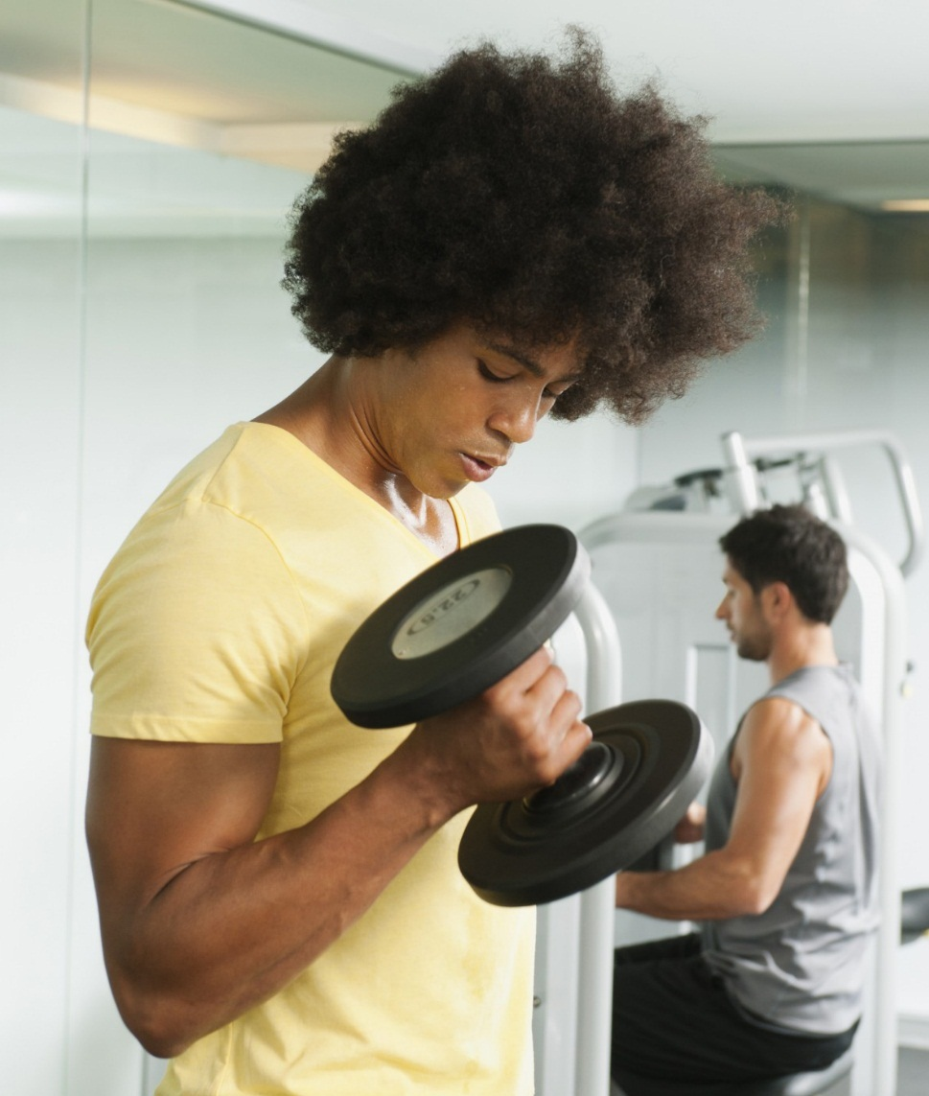
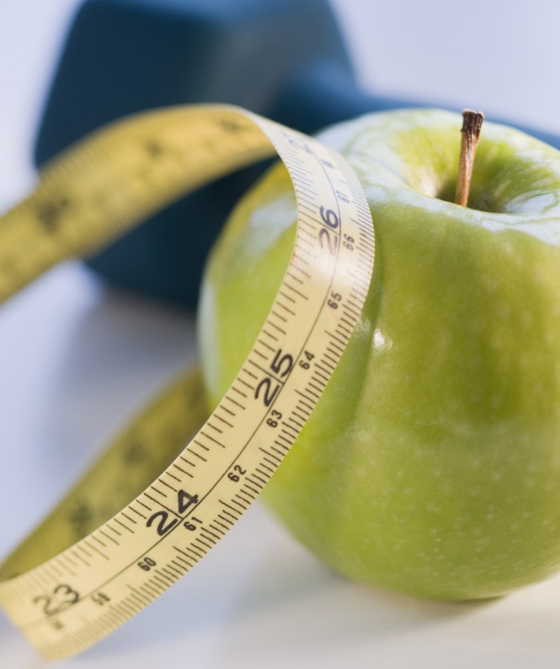
English morning reading: Steep rise in obesity and problem drinking
Source: 28th november, 2017 (Tuesday)
Date of session: 4th december, 2017 (monday)
Classes: 6A + 6B
Notes:
NOTE: To replace a picture, just select and delete it. Then use the Insert Picture icon to replace it with one of your own!

Slide 2
B. vocabulary
estimate [v] (L24) – guess, calculate
E.g. estimate the cost
impetus [n] (L49) – motivation, urge
E.g. a new impetus
teetotaller [n] (L57-58) – a person never drinks alcohol
E.g. a teetotaller having a clear mind
confess [v] (L63) – admit
E.g. confess to the murder
binge drinking [nphr] (L63-64) – drinking too much alcohol
E.g. admit to binge drinking

Slide 3
C. useful expressions
a surge in [sub headline]
Meaning: a sudden or great increase in (something)
Example: A surge in electrical power caused computer to crash.
curb the prevalence of [L64]
Meaning: limit the commonness of
Example: The new measure helps to curb the prevalence of obesity in adults.

Slide 4
D. IP Question
What should be done to curb the prevalence of obesity and problem drinking in Hong Kong? Suggest two measures and explain.
Preparation: 2 minutes (note-taking)
Discussion: 2 minutes (Pair work)
Presentation: 1 minute (IP)
Presenters: 6A ( 20 ), 6B ( 20 )

