Slide 1
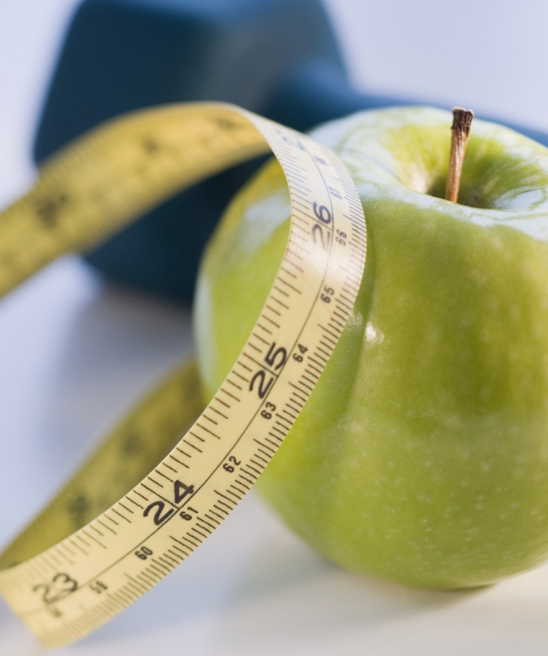
English morning reading: choice of restaurant may be key to healthier eating
Source: 16th november, 2017 (Thursday)
Date of session: 20th November, 2017 (Monday)
Classes: 6C + 6D
Notes:
NOTE: To replace a picture, just select and delete it. Then use the Insert Picture icon to replace it with one of your own!

Slide 2
B. vocabulary
discrepancy [n] (L12-13) – difference, variation
E.g. the discrepancy between two accounts
evaluate [v] (L23-24) – assess, judge
E.g. evaluate the results
whopping [adj] (L35) – extremely large
E.g. a whopping lie
excessive [adj] (L52) – too much
E.g. excessive exercise
reformulate [v] (L61) – plan again, work out again
E.g. reformulate the sentence

Slide 3
C. useful expressions
in terms of (something) [L32]
Meaning: in relation to (something)
Example: We try to do what is best for our customers in terms of the quality of our products.
in place [L64]
Meaning: ready
Example: The arrangements are all in place for the concert next Thursday.

Slide 4
D. IP Question
Do you think the Calorie Label Scheme would help the Hong Kong citizens to become healthier? Why / Why not?
Preparation: 2 minutes (note-taking)
Discussion: 2 minutes (Pair work)
Presentation: 1 minute (IP)
Presenters: 6C ( 2 ), 6D ( 2 )

